Slide 1


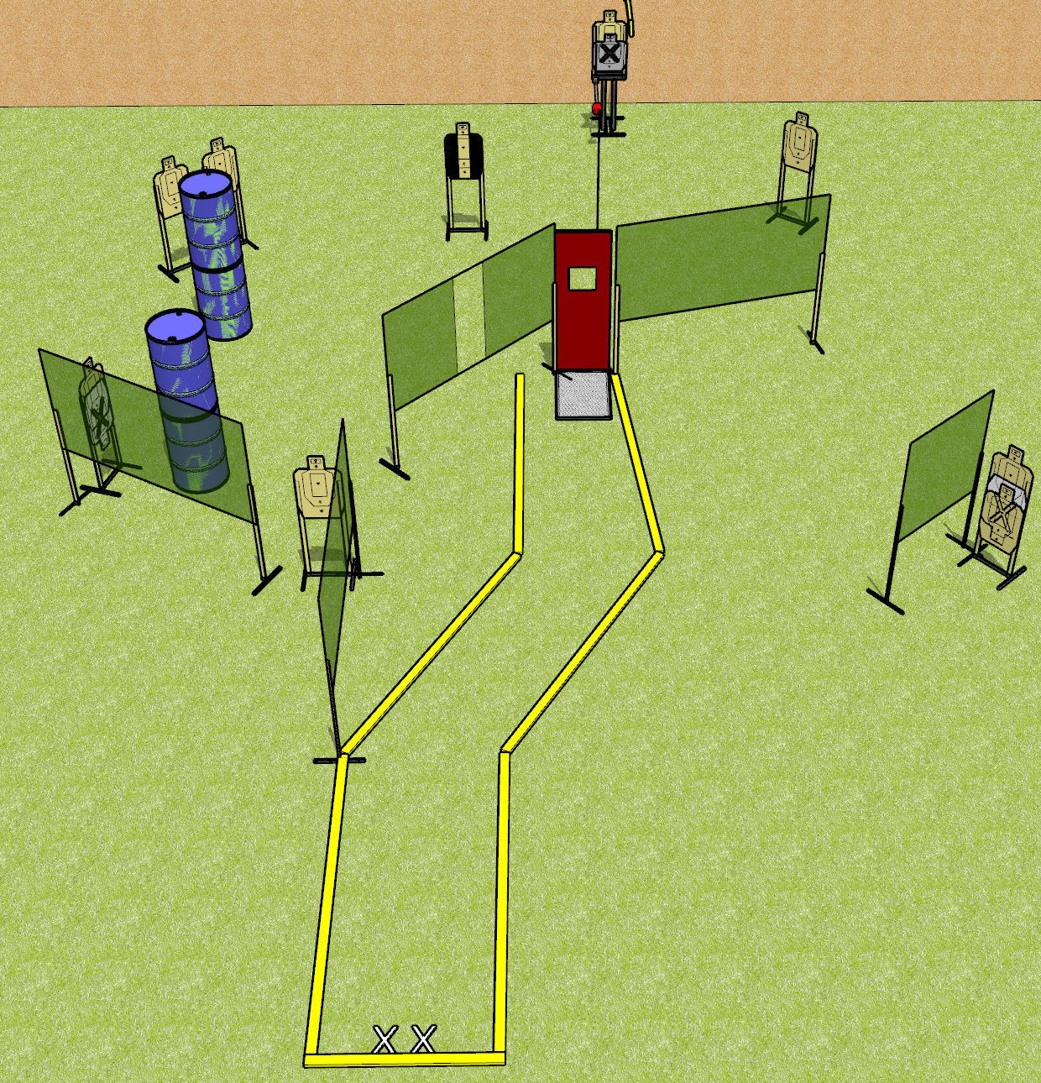
 | Dothan Gun Club – USPSA Match The Collapse Course Designer : Drew Coleman
Round Count 18 rounds 9 USPSA targets
Equipment List 10 wall feet Max trap Pull cord window set up as activator 1 tuxedo

Slide 2
The Collapse
Written Stage Briefing
The Collapse is an 18 round, 90 point, Comstock course of fire. There are 9 USPSA targets. The best 2 hits on paper will score, and steel must fall to score. The start signal is audible.
The max trap is activated by the window prop and is visible at rest. Please check the activator prior to walkthrough and set it the same way every time.
Handgun start position is heels on X’s, wrists below belt. Handgun is loaded and holstered.
PCC start position is heels on X’s. Loaded carbine is held with both hands, stock on belt, safety on.
On start signal, engage targets as they become available from within the shooting area.

